Slide 1
Python for NLP
By Dr. Ali Saeed

Slide 2
Introduction to Python
Definition
Variables / Arrays/ List / Set / Tuple
Dictionary
Condition
Loops
Classes
Functions
Popular Libraries

Slide 3
Condition
a = 33
b = 200
if (b > a):
print("b is greater than a")
a = 200
b = 33
if b > a:
print("b is greater than a")
elif a == b:
print("a and b are equal")
else:
print("a is greater than b")
a=30
b=20
if(b>a):
print("hello")
elif(a>b):
print("world")
a = 33
b = 200
if (b > a and a==32):
print("b is greater than a")

Slide 4
Loop
Traversing from set:
thisset = {"apple", "banana", "cherry"}
for x in thisset:
print(x)
Range 2-5:
for x in range(2, 6):
print(x)
Traversing from list:
thisset = ["apple", "banana", "cherry“]
for x in thisset:
print(x)
Range 2-29, with increment of 3:
for x in range(2, 30, 3):
print(x)
i=10
j=10
while(i<20 and j<15):
print(i)
i=i+1
j=j+1
i = 1
while i < 6:
print(i)
i += 1
Range 0-5:
for x in range(6):
print(x)

Slide 5
Functions
def my_function():
print("Hello from a function")
my_function()
def my_function(fname):
print(fname + " Refsnes")
my_function("Emil")
my_function("Tobias")
my_function("Linus")
def my_function():
print("Hello from a function")
print("Hello from a function")
print("Hello from a function")
print("Hello from a function")
my_function()
def my_function(food):
for x in food:
print(x)
fruits = ["apple", "banana", "cherry"]
my_function(fruits)

Slide 6
Input
Following code will takes input in string and convert into string
q=input()
r=q.split(" ")
print(r)
print(r[0])

Slide 7
Class / Objects
class Person:
name="No name"
age = 0
def __init__(self, name, age):
self.name=name
self.age=age
def print_fun(self):
print(self.name)
print(self.age)
p1= Person("Usman", 30)
p1.print_fun()
All classes have a function called __init__(), which
is always executed when the class is being initiated.
Use the __init__() function to assign values to
object properties, or other operations that are
necessary to do when the object is being created.
All function have an extra parameter of self

Slide 8
Class / Objects
class Person:
def __init__(self, name, age):
self.name = name
self.age = age
def myfunc(self):
print("Hello my name is " + self.name)
p1 = Person("John", 36)
p1.myfunc()
The self parameter is a reference to the
current instance of the class, and is used
to access variables that belongs to the
class.
It does not have to be named self , you
can call it whatever you like, but it has to
be the first parameter of any function
in the class:
If we have a method that takes no arguments,
then we still have to have one argument.

Slide 9
Mount files from Google Colab
from google.colab import drive
drive.mount('/content/drive')

Slide 10
Pandas
Pandas is a Python library used for working with data sets.
It has functions for analyzing, cleaning, exploring, and manipulating data.
The name "Pandas" has a reference to both "Panel Data", and "Python Data Analysis"
and was created by Wes McKinney in 2008.
A Pandas DataFrame is a 2 dimensional data structure,
like a 2 dimensional array, or a table with rows and columns.

Slide 11
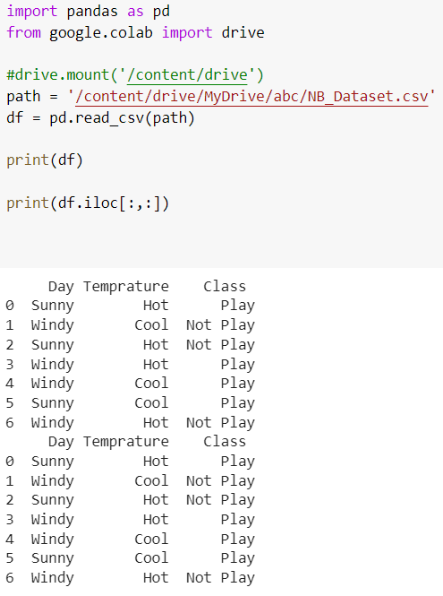
Fetch all rows and columns

Slide 12
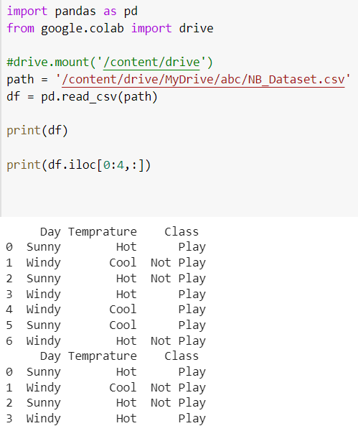
First 3 rows along with all columns

Slide 13
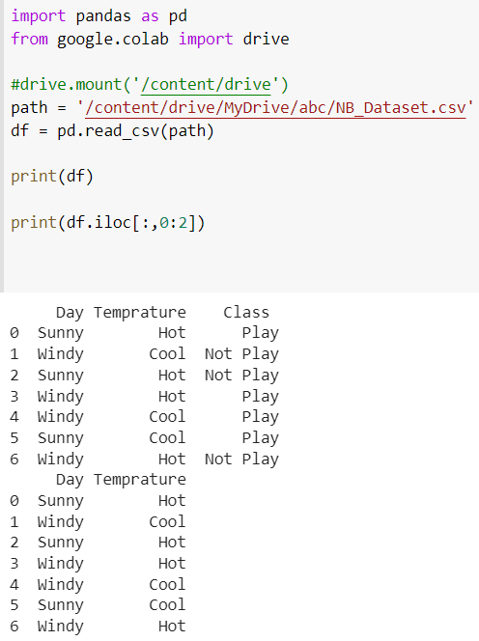
First two columns with all rows

Slide 14
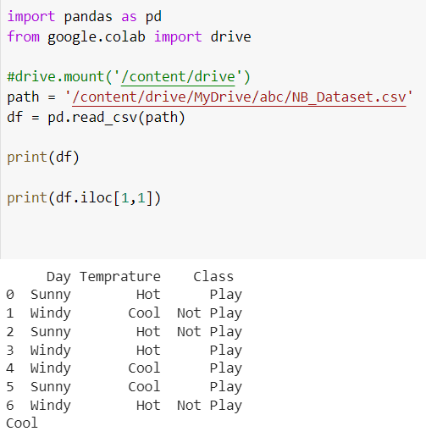
Access a specific cell value

Slide 15
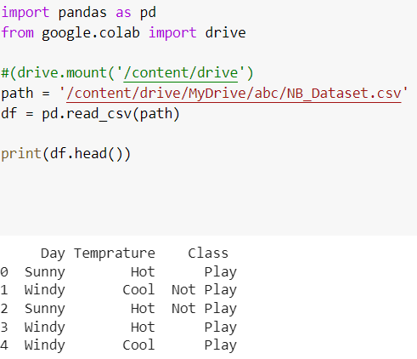
Pandas Function
Df.head()
It is use to show first 5 rows of dataset
Df.head(10)
It is use to show first 10 rows of dataset
Df.tail()
It is use to show last 5 rows of dataset

Slide 16
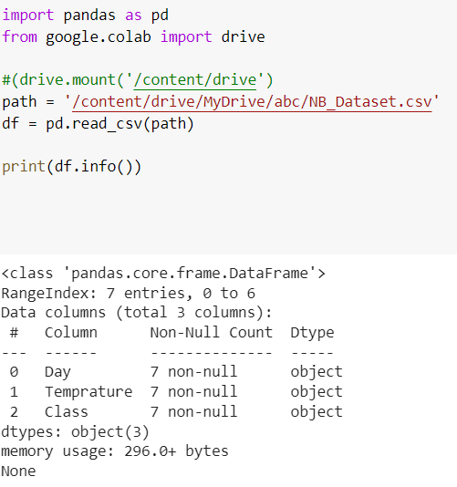
Data Frame Info

Slide 17
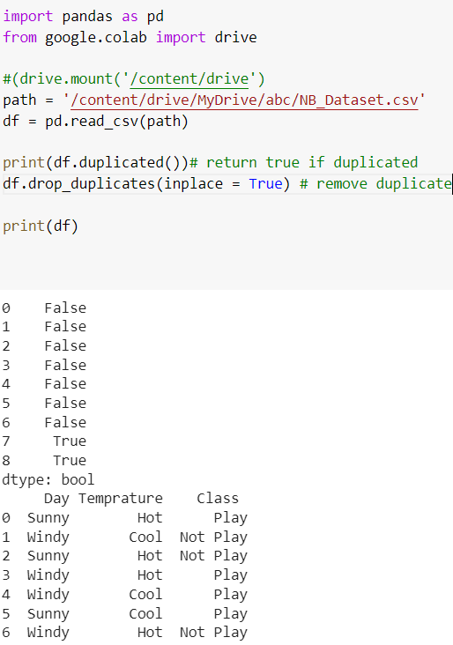
Remove duplicate

Slide 18
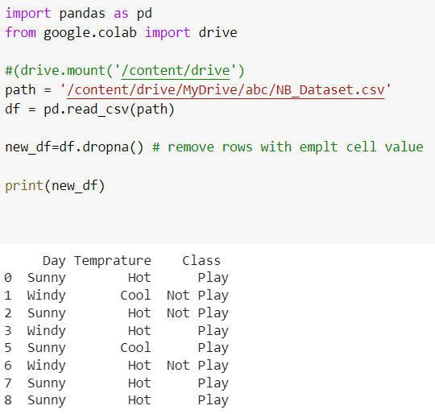
Remove Rows with null value

Slide 19
Thanks

